Slide 1
Using Machine Learning and Deep Learning for the Detection of Cyberbullying in Messages.
Jack Leyland
1st February 2019

Slide 2
Problem Description (High-Level)
Can I reliably predict Cyberbullying?
i.e. Can I create a model which, when given an unseen message, can reliably output whether this message is cyberbullying or not?
Cyberbullying
Cyberbullying Detector
“Hello, I think you are an idiot”
Not cyberbullying

Slide 3
Motivation
1
I have personally experienced Cyberbullying
12% of 12-15 year old's have been cyberbullied in the last 12 months
Now as common as face-to-face bullying!
75% of 12-15 year old’s are aware of social media reporting features
…and only 12.5% of these have ever used them.
2
3

Slide 4
Research Questions
What makes a good dataset for this task?
How can I pre-process given datasets to ensure high performance from my models?
Apriiiiiiiiiiiill!!! I miss uuuu! It&#039;s Emma btw haha
clean data
April! I miss you! It’s Emma by the way haha.

Slide 5
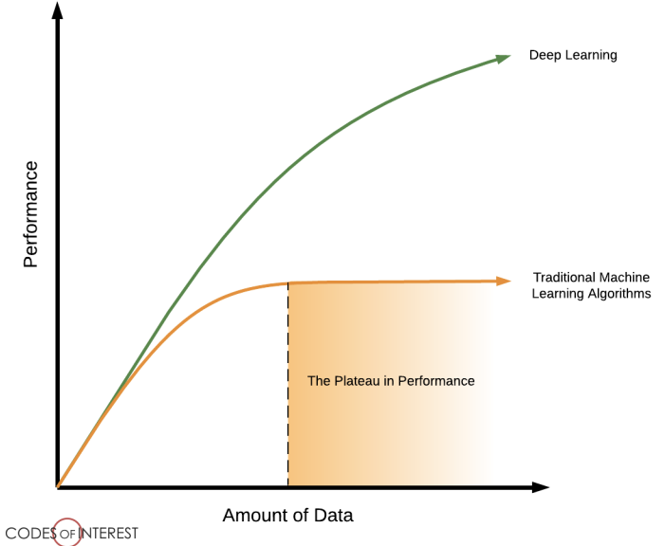
Research Questions
Which Deep Learning architectures give the best results for the classification of messages?
Can this model generalise to other datasets and show high performance there?
Is Deep Learning more appropriate than traditional Machine Learning for this task?

Slide 6
What is the difference?

Slide 7
What is the difference?
Machine learning
Makes informed decision based on the data
A ’function’ based on statistical techniques
Deep Learning:
Multi-layered Neural Networks
Backpropagation
Learns on its own over time

Slide 10
Previous Work
Machine Learning > Deep Learning
Traditional Machine Learning methods
Reynolds and Kontostathis (2011) → 67.4% recall
Bastidas et. al (2016) → 71.0% recall and 80% precision
Deep Learning methods
Badjatiya et. al (2017) → 93.0% recall 93.0% precision
State of the art! But….
Notes:
Add about Racism/Sexism and why I am doing it

Slide 11
My Approach
1. Search for dataset
Open source datasets
Try GitHub, contact researchers
Remove punctuation, repeated letters, hashtags etc.
Make lowercase, spellcheck
2. Clean dataset
Feature extraction (TF, TF-IDF, GloVe, etc.)
Models (Logistic Regression, SVM, etc.)
3. Machine Learning
(Pre-trained) word embeddings
Architectures
Generalisation
4. Deep Learning
Final detector that users can interact with
Create my own public dataset
5. Finishing Touches

Slide 12
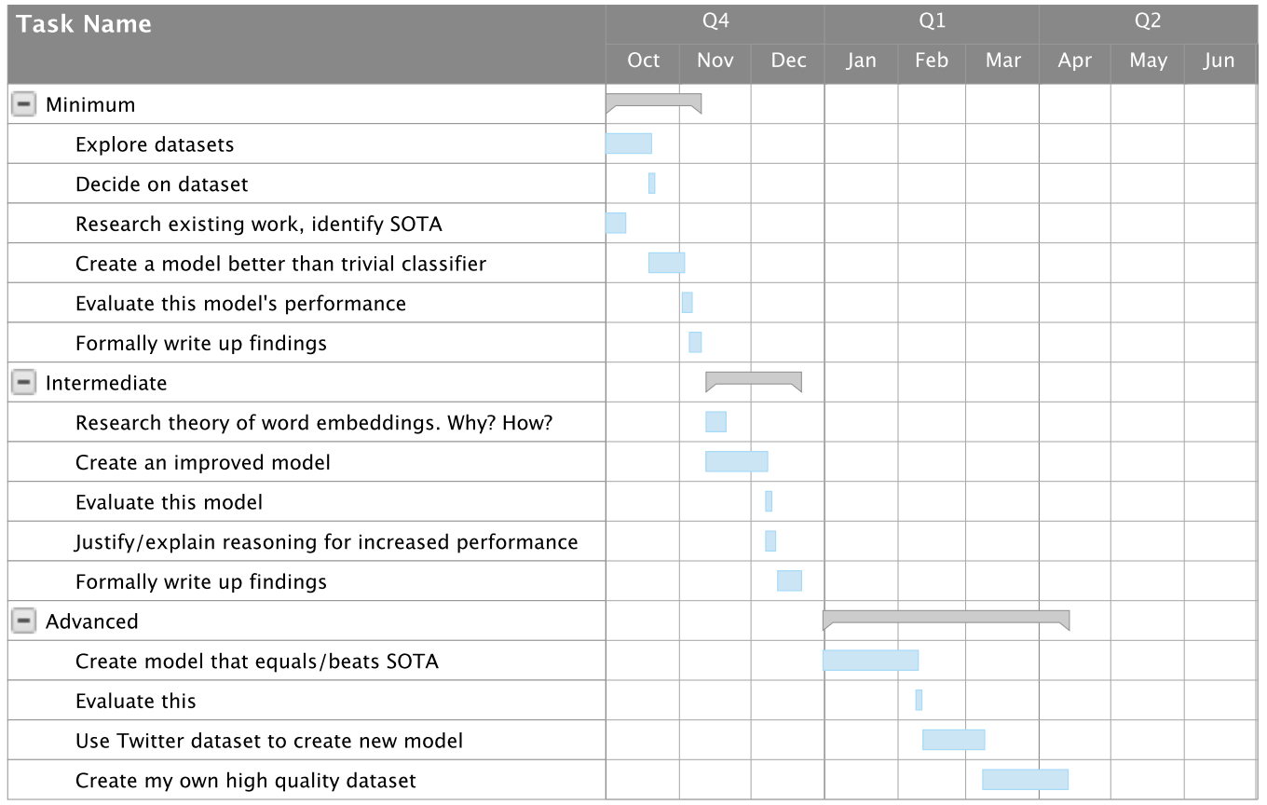
Planning
Dataset and
Machine Learning
Deep Learning
Finishing touches
Generalisation to Twitter

Slide 13



What I have accomplished
1. Search for dataset
Open source datasets
Try GitHub, contact researchers
Remove punctuation, repeated letters, hashtags etc.
Make lowercase, spellcheck
2. Clean dataset
Feature extraction (TF, TF-IDF, GloVe, etc.)
Models (Logistic Regression, SVM, etc.)
3. Machine Learning
(Pre-trained) word embeddings
Architectures
Generalisation
4. Deep Learning
Final detector that users can interact with
Create my own public dataset
5. Finishing Touches

Slide 14
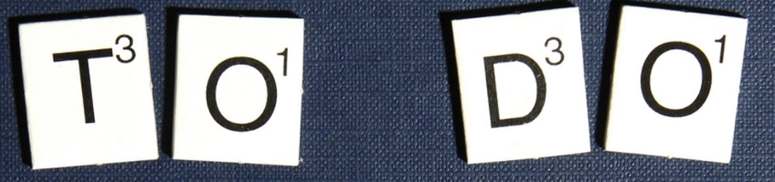
What still needs to be done
Pre-process my data (spellcheck?)
Continue to experiment with Deep Learning
Evaluate generalisation capabilities
Create my own public dataset
Evaluate my work!

Slide 15
Precision and Recall
Why not accuracy?

Slide 16
Precision and Recall
Actual
 | Cyberbullying | NOT Cyberbullying
Cyberbullying | True Positive | False Positive
NOT Cyberbullying | False Negative | True Negative
Predicted

Slide 17
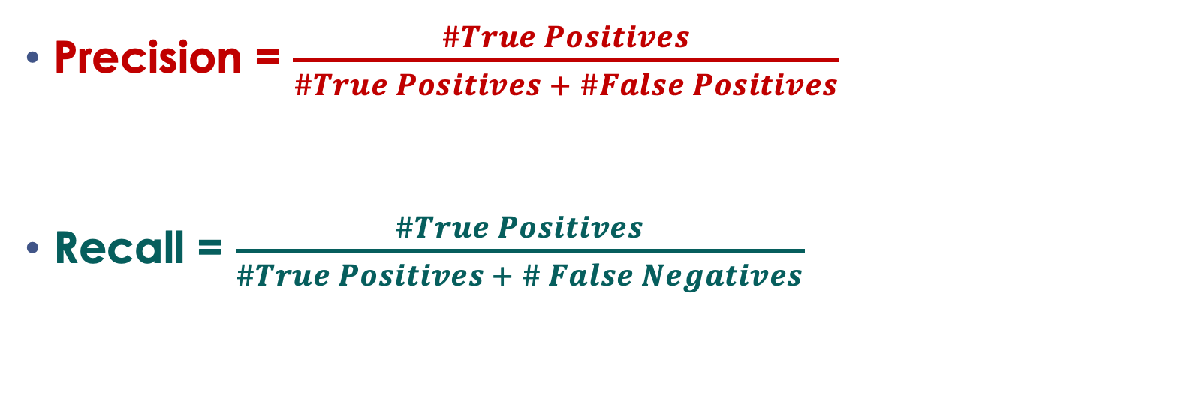
Precision = $\frac{\#True Positives}{\#True Positives + \#False Positives}$
Recall = $\frac{\#True Positives}{\#True Positives + \# False Negatives}$
Actual
 | Cyberbullying | NOT Cyberbullying
Cyberbullying | #True Positives | #False Positives
NOT Cyberbullying | #False Negatives | #True Negatives
Predicted

Slide 18

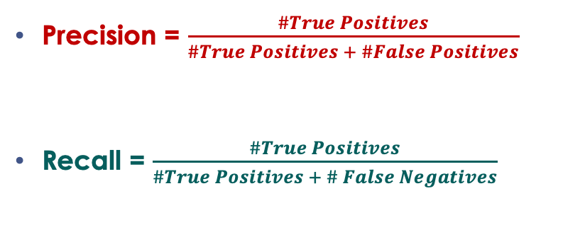
Precision = $\frac{\#True Positives}{\#True Positives + \#False Positives}$
Recall = $\frac{\#True Positives}{\#True Positives + \# False Negatives}$
F1 score = $2∗\frac{(Precision∗Recall)}{(Precision+Recall)}$
Actual
 | Cyberbullying | NOT Cyberbullying
Cyberbullying | #True Positives | #False Positives
NOT Cyberbullying | #False Negatives | #True Negatives
Predicted

Slide 19
Analysis & Evaluation
I want to maximise F1 score, detecting cyberbullying, but not detecting too much.
Also used for generalization to new datasets.
State of the Art, F1 = 0.930

Slide 20
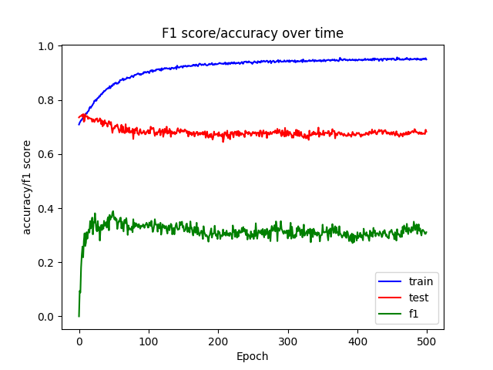

Slide 21
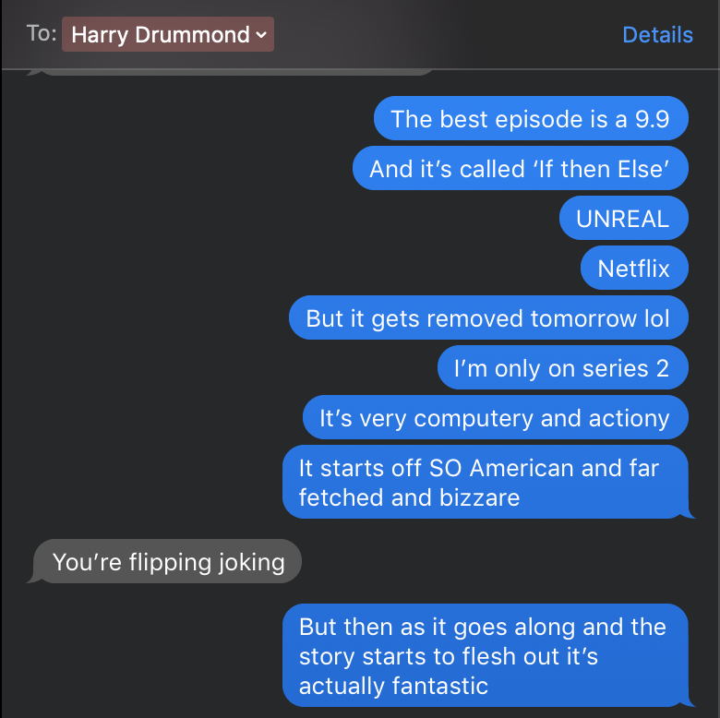
Conclusion
User
Produce an accurate Cyberbullying detector which the user will interact with
Welcome to Cyberbullying detector. Enter a message
I hate you
That is Cyberbullying.

Slide 22
Thank you
Any questions?

Slide 23
Bibliography (1/2)
Badjatiya, P., Gupta, S., Gupta, M. & Varma, V. (2017), Deep Learning for Hate Speech Detection in Tweets, Hyderabad, Microsoft.
Bastidas, A., Dixon, E., Loo, C. & Ryan, J. (2016), Harrassment detection: a benchmark on the #HackHarrassment dataset, Intel.
Reynolds, K. & Kontostathis, A. (2011), Using Machine Learning to Detect Cyberbullying, Ursinus College.

Slide 24
Bibliography (2/2)
Martin Holub – Machine Learning plateau graph
Royalty-Free Images - https://www.pexels.com/royalty-free-images/
Venn diagram - https://datafloq.com/read/what-everyone-should-know-about-machine-learning/3465
Neural Network graph - https://medium.freecodecamp.org/want-to-know-how-deep-learning-works-heres-a-quick-guide-for-everyone-1aedeca88076

